Slide 1
2-D VIEWING AND CLIPPING

Slide 2
Clipping
the procedure that identifies the portions of a picture lie inside the region.
Point Clipping
Line Clipping
Polygon Clipping
Text Clipping
Curve Clipping
Any object that is not entirely within the viewport must be clipped.
the part that is outside the viewport must be eliminated.

Slide 3
Line Clipping
Before clipping
After clipping
C
C
B
D
B
D
A
E
E
F'
A
G
F
G
F
G'
H'
H
H

Slide 4
Process
If a line is partially in the viewport, then we need to recalculate its endpoints.
In general, there are four possible cases.
The line is entirely within the viewport.
The line is entirely outside the viewport.
One endpoint is in and the other is out.
Both endpoints are out, but the middle part is in.

Slide 5
Line Clipping Algorithms:
• Cohen Sutherland Line Clippings
• Cyrus-Beck Line Clipping Algorithm

Slide 6
Cohen-Sutherland Clipping Algorithm
Let the x-coordinates of the window boundaries be x_{min} and x_{max} and let the y-coordinates be y_{min} and y_{max}.
For each endpoint p of a line segment we will define a 4-bit code consisting of 4 true/false values.
C = true, if p is left of the window.
C = true, if p is above the window.
C = true, if p is right of the window.
c = true, if p is below the window.
How many different values are possible for a codeword?
ymax
ymin
xmin
xmax

Slide 7
Code
1001
1000
1010
1st Bit= If above top edge then 1 else 0
2nd Bit= If below bottom edge then 1 else 0
3rd Bit= If right of right edge then 1 else 0
4th Bit= If left of left edge then 1 else 0
ymax
0001
0000
0010
ymin
0101
xmin
0100
xmax
0110
1st bit ⇒ Up(U) ; 2nd bit ⇒ Down(D) ; 3rd bit ⇒ Left(L) ; 4th bit ⇒ Right(R) (U,D,L,R)

Slide 8
Testing:
perform Line clipping for various line segment
which may reside inside the window region fully or partially,
or may not even lie in the widow region;
we use the tool of logical ANDing between the UDLR codes of the points lying on the line.
Logical ANDing (^) operation => 1 ^ 1 = 1; 1 ^ 0 = 0; 0 ^ 1 = 0; 0 ^ 0 = 0

Slide 9
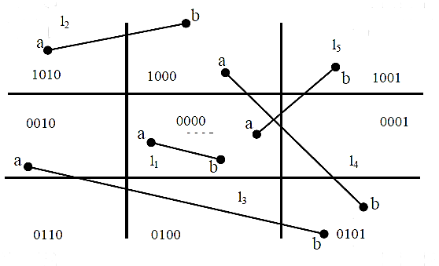
Cases
line l¹ is completely visible, l² and l³ are completely invisible; l⁴and l⁵ are partially visible. We will discuss these out comings as three separate cases.
Case 1: l¹ → Completely visible, i.e., Trival acceptance (∴both points lie inside the window)
Case 2: l² and l³ → Invisible , i.e., Trival acceptance rejection
Case 3: l⁴ and l⁵→ partially visible (∴partially inside the window)
Now, let us examine these three cases with the help of this algorithm:
Case 1: (Trivial acceptance case) if the UDLR bit codes of the end points P,Q of a given line is 0000 then line is completely visible. Here this is the case as the end points a and b of line l¹ are: a (0000), b (0000). If this trival acceptance test is failed then, the line segment PQ is passed onto Case 2.
Case 2: (Trivial Rejection Case) if the logical intersection (AND) of the bit codes of the end points P, Q of the line segment is ≠ 0000 then line segment is not visible or is rejected.

Slide 10
Steps
1) Assign the region codes to both endpoints.
2) Perform OR operation on both of these endpoints.
3) if OR = 0000,
then it is completely visible (inside the window).
else
Perform AND operation on both these endpoints.
i) if AND ? 0000,
then the line is invisible and not inside the window. Also, it can’t be considered for clipping.
ii) else
AND = 0000, the line is partially inside the window and considered for clipping.
4) After confirming that the line is partially inside the window, then we find the intersection with the boundary of the window. By using the following formula:-
Slope:- m= (y2-y1)/(x2-x1)
a) If the line passes through top or the line intersects with the top boundary of the window.
x = x + (y_wmax – y)/m, y = y_wmax
b) If the line passes through the bottom or the line intersects with the bottom boundary of the window.
x = x + (y_wmin – y)/m, y = y_wmin
c) If the line passes through the left region or the line intersects with the left boundary of the window.
y = y+ (x_wmin – x)*m, x = x_wmin
d) If the line passes through the right region or the line intersects with the right boundary of the window.
y = y + (x_wmax -x)*m, x = x_wmax
5) Now, overwrite the endpoints with a new one and update it.
6) Repeat the 4th step till your line doesn’t get completely clipped
Given a set of lines and a rectangular area of interest, the task is to remove lines that are outside the area of interest and clip the lines which are partially inside the area.

